Slide 2
Objectives
^{Explain functions}
Explain parameterized functions
^{Explain return statement}
^{Describe objects}
Explain different browser objects
Describe Document Object Model (DOM)

Slide 3
Introduction
To make the code more task-oriented and manageable, JavaScript allows to group statements before they are actually invoked.
This can be achieved by using functions.
A function is a reusable block of code that is executed on the occurrence of an event.
Event can be a user action on the page or a call within the script.

Slide 4
Functions
Is an independent reusable block of code that performs certain operations on variables and expressions to fulfill a task.
Might accept parameters, which are variables or values on which it performs operations.
Might return the resultant value to display it in the browser after the operations have been performed.
JavaScript function is always created under the script element.
JavaScript supports both user-defined and built-in functions.

Slide 5
Declaring and Defining Functions 1-3
JavaScript allows declaring a function using the function keyword.
Keyword is followed by the name of the function and the parameters enclosed within the parenthesis.
If the function does not accept any parameters, then it must be specified with an empty parenthesis.
Once the function is declared, you need to define the function by specifying the operations or instructions within the curly braces “{“ and “}”.
Curly braces indicate the start and end of the function block, which is collectively referred to as the body of the function.
A function must be defined before it can be invoked in the script and multiple functions can be defined within the script element.

Slide 6
Declaring and Defining Functions 2-3
Cannot begin with a digit and cannot contain spaces
Naming of Functions
Can consist of letter, digits, and underscore
Cannot be a JavaScript keyword
Can begin only with a letter or an underscore

Slide 7
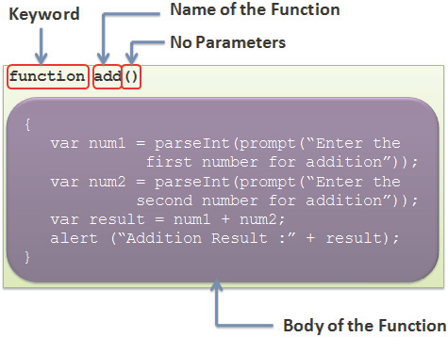
Declaring and Defining Functions 3-3
Syntax to create a function in JavaScript is as follows:
function function_name(list of parameters)
{
^{// Body of the function}
}

Slide 8
Invoking Functions 1-2
A function need to be invoked or called to execute it in the browser.
To invoke a function, specify the function name followed by parenthesis outside the function block.
A function can be defined and invoked even in an external JavaScript file.
A function can be called from another function in JavaScript.
A function that invokes another function is called the calling function; whereas the function that is called is referred to as the called function.
Functions provide the benefit of code reusability by allowing the user to call a function multiple times.

Slide 9
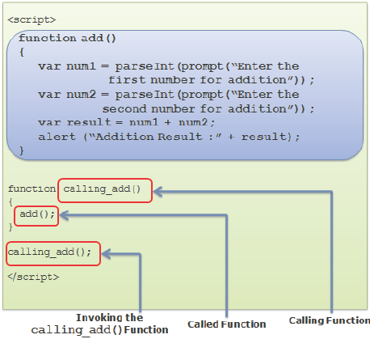
Invoking Functions 2-2

Slide 10
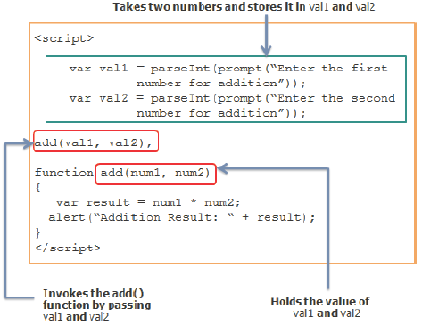
Parameterized Functions
Parameterized Functions
Refer to the JavaScript functions that accept parameters
Can be created when there is a need to accept values from the user
Parameters hold values on which the function needs to perform operations

Slide 11
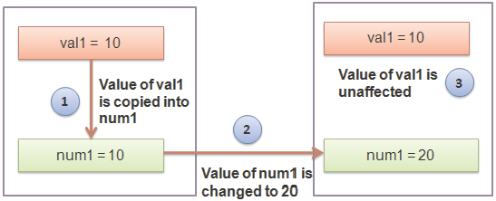
Ways of Passing Arguments 1-3
There are two ways of passing arguments to a function namely, pass by value and pass by reference.
Passing by value - Refers to passing variables as arguments to a function. Called function do not change the values of the parameters passed to it from the calling function.

Slide 12
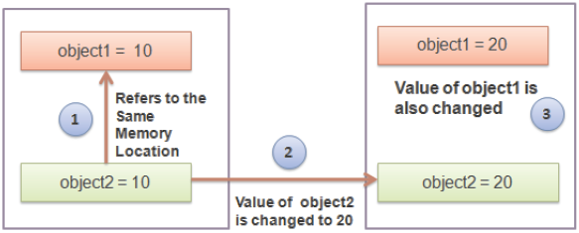
Ways of Passing Arguments 2-3
Passing by reference - Refers to passing objects as arguments to a function.
The called function modifies the value of the parameters passed to it from the calling function.
This change is reflected when the control passes back to the calling function.

Slide 13
Ways of Passing Arguments 3-3
The Code Snippet demonstrates passing of Array object as a parameter to a function.
^{<script>}
var names =new Array(‘James’, ‘Kevin’, ‘Brad’);
^{function change_names(names){}
^{names[0]= ‘Stuart’;}
}
^{function display_names(){}
document.writeln(‘<H3> List of Student Names:</H3>’);
^{document.write(‘<UL>’);}
for(vari=0; i<names.length; i++) {
document.write(‘<LI>’ + names[i]+ ‘</LI>’);
}
^{document.write(‘</UL>’);}
^{change_names(names);}
document.write(‘<H3> List of Changed Students Names:</H3>’);
^{document.write(‘<UL>’);}
for(vari=0; i<names.length; i++) {
document.write(‘<LI>’ + names[i]+ ‘</LI>’);
}
^{document.write(‘</UL>’);}
}
^{display_names(names);}
^{</script>}

Slide 14
return Statement 1-2
Returns the control to the calling function because of unexpected results
return Statement
Can also be used to halt the execution of the function
Allows sending the result back to the calling function
Begins with return keyword followed by the variable or value

Slide 15
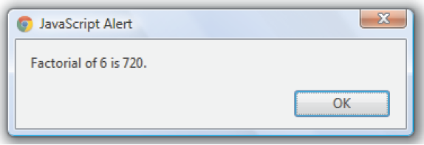
return Statement 2-2
The Code Snippet demonstrates the use of return statement.
^{<script>}
^{function factorial(num) {}
^{if(num==0)}
^{return0;}
^{elseif(num==1)}
^{return1;}
^{else}
{
^{var result =num;}
^{while(num>1)}
{
^{result = result *(num-1);}
^{num--;}
}
^{return result;}
}
}
varnum=prompt(‘Enter number:’,’’);
^{var result = factorial(num);}
alert(‘Factorial of ‘ +num+ ‘ is ‘ + result + ‘.’);
^{</script>}

Slide 16
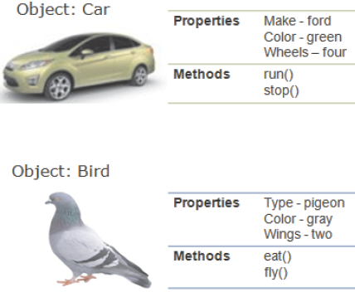
Objects 1-2
Are entities with properties and methods and resemble to real life objects.
Properties specify the characteristics or attributes of an object.
Methods identify the behavior of an object.

Slide 17
Objects 2-2
JavaScript provides built-in objects and allows creating user-defined objects.
Built-in Objects - Are pre-defined objects which are already defined. Their properties and methods need to be called to fulfill a task.
Custom Objects - Are user-defined objects, which the developer explicitly creates in the script and defines their properties and methods.

Slide 18
Creating Custom Objects 1-5
Object object is the parent object from which all the JavaScript objects are derived.
Custom objects can be derived from this object by using the new keyword.
Two main methods to create a custom object namely, direct method and by defining a template and initializing it with the new keyword.

Slide 19
Creating Custom Objects 2-5
Syntax to create object using these methods is as follows:
^{Direct Method}
var object_name = new Object();
^{where,}
object_name: Is the name of the object.
new: Is the keyword that allocates memory to the custom object. This is known as instantiation of an object.
object: Is the built-in JavaScript object that allows creating custom objects.

Slide 20
Creating Custom Objects 3-5
^{Template Method}
An object’s template refers to a structure that specifies the custom properties and methods of an object.
First, the object type is declared using a constructor function.
Second, you specify the object of the declared object type by using the new keyword.
JavaScript allows creating a reusable template without having to redefine properties and methods repeatedly to fulfill a particular object’s requirements.
This template is known as the constructor function.

Slide 21
Creating Custom Objects 4-5
^{Template Method}
A constructor function is a reusable block that specifies the type of object, its properties, and its methods.
It might or might not take any parameters.
After creating the constructor function, you specify an object of the declared object type using the new keyword.
new keyword allocates memory to the object and invokes the constructor function.
Syntax to create a constructor function is as follows:
function object_type(list of parameters)
{
// Body specifying properties and methods
}

Slide 22
Creating Custom Objects 5-5
Syntax to create a object using the new keyword is as follows:
object_name = new object_type(optional list of arguments);
The Code Snippet shows the creation of objects using direct and template method is as follows:
^{<script>}
//create an object using direct method
var doctor_details=new Object();
//create an object using new keyword
studOne = new student_info (‘James’, ‘23’, ‘New Jersey’);
^{</script>}

Slide 23
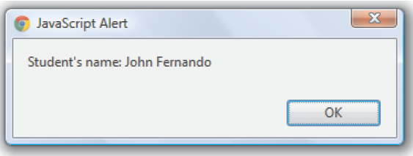
Creating Properties for Custom Objects 1-2
Properties specify the characteristics of an object created through Object or template method.
To access a property of an object created using Object object, specify the object name followed by a period and the property name.
The Code Snippet demonstrates the script that creates the student_details object.
^{<script>}
var student_details=new Object();
student_details.first_name= ‘John’;
student_details.last_name= ‘Fernando’;
^{student_details.age= ‘15’;}
alert(‘Student\’s name: ‘ +student_details.first_name+ ‘ ‘ +student_details.last_name);
^{</script>}

Slide 24
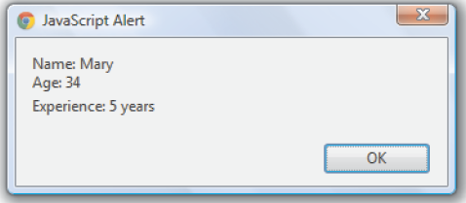
Creating Properties for Custom Objects 2-2
The Code Snippet creates the employee_info object and adds properties in the constructor function.
^{<script>}
^{// To define the object type}
function employee_info(name, age, experience)
{
^{this.name = name;}
^{this.age= age;}
^{this.experience= experience;}
}
// Creates an object using new keyword
empMary=newemployee_info(‘Mary’, ‘34’, ‘5 years’);
alert(“Name: “+ empMary.name + ‘\n’ +”Age: “+empMary.age+ ‘\n’ +”Experience: “+empMary.experience);
^{</script>}

Slide 25
Creating Methods for Custom Objects
Methods are similar to JavaScript functions.
A method is associated with an object and is executed by referring to that object but a function is not associated with any object and is executed independently.
One or more methods can be specified after creating an object using the Object object or while creating the template.
To invoke a method, they must be specified with the object name followed by a period, method name, and parenthesis with parameters, if any.
The Code Snippet demonstrates the script that defines a custom method.
^{<script>}
^{var square =new Object();}
^{square.length=parseInt(“5”);}
^{square.cal_area=function() {}
var area =(parseInt(square.length)*parseInt(“4”));
^{return area;}
}
alert(“Area: “+square.cal_area());
^{</script>}

Slide 26
Built-in Objects
Object model of JavaScript language forms the foundation of the language.
These objects help to provide custom functionalities in the script.
JavaScript treats the primitive data types as objects and provide equivalent object for each of them.
JavaScript objects are categorized as built-in objects, browser objects, and HTML objects.
Built-in objects are static objects which can be used to extend the functionality in the script.
Browser objects, such as window, history, and navigator are used to work with the browser window.
HTML objects, such as form, anchor, and so on are used to access elements on the Web page.

Slide 27
String Object 1-3
Strings in JavaScript are a set of characters that are surrounded by single or double quotes.
Built-in String object allows you to perform different text operations on them.
String object is instantiated with the new keyword, which invokes the predefined constructor function of the String object.
Syntax to initialize the String object is as follows:
var object_name = new String(“Set of characters”) ;
Following table lists properties of the String object.
^{Property} | ^{Description}
^{length} | Retrieves the number of characters in a string.
^{prototype} | Adds user-defined properties and methods to the String instance.

Slide 28
String Object 2-3
Following table lists the methods of the String object.
^{Method} | ^{Description}
^{charAt()} | Retrieves a character from a particular position within a string.
^{concat()} | Merges characters from one string with the characters from another string and retrieves a single new string.
^{indexOf()} | Retrieves the position at which the specified string value first occurred in the string.
^{lastIndexOf()} | Retrieves the position at which the specified string value last occurred in the string.
^{replace()} | Matches a regular expression with the string and replaces it with a new string.
^{search()} | Searches for a match where the string is in the same format as specified by a regular expression.
^{split()} | Divides the string into substrings and defines an array of these substrings.
^{substring()} | Retrieves a part of a string between the specified positions of a string.
^{toLowerCase()} | Specifies the lowercase display of the string.

Slide 29
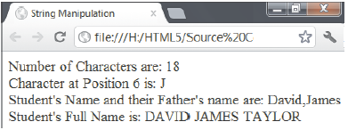
String Object 3-3
The Code Snippet demonstrates the script that creates a String object and test various methods.
^{<script>}
var full_name=new String(‘David James Taylor’);
document.write(‘Number of Characters are: ‘ +full_name.length+ ‘<BR/>’);
document.write(‘Character at Position 6 is: ‘ +full_name.charAt(6)+ ‘<BR/>’);
document.write(‘Student\’s Name and their Father\’s name are: ‘ +full_name.split(‘ ‘,2)+ ‘<BR/>’);
document.write(‘Student\’s Full Name is: ‘ +full_name.toUpperCase());
^{</script>}

Slide 30
Math Object 1-2
Math object allows the user to perform mathematical operations on numeric values.
Math object is a pre-defined object that provides static properties and methods to perform mathematical operations.
Properties and methods are declared as static, thus they can be invoked directly with the object name.
Syntax to access the properties of the Math object is as follows:
var variable_name = Math.PropertyName;
Syntax to invoke the methods of the Math object is as follows:
var variable_name = Math.MethodName(optional list of parameters);

Slide 31
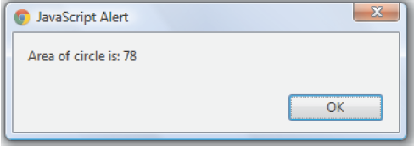
Math Object 2-2
The Code Snippet demonstrates the script that creates a Math object.
^{<script>}
var full_name=new String(‘David James Taylor’);
document.write(‘Number of Characters are: ‘ +full_name.length+ ‘<BR/>’);
var area =Math.floor(tempArea);
^{return area;}
}
alert(‘Area of circle is: ‘ +area_circle(5));
^{</script>}

Slide 32
Date Object 1-3
Date object allows you to define and manipulate the date and time values programmatically.
It supports both the Universal Time Coordinated (UTC) and Greenwich Mean Time (GMT) conventions.
Date object calculates dates in milliseconds from 01 January, 1970.
Syntax to instantiate the Date object is as follows:
^{var object_name = new Date();}
var object_name = new Date(milliseconds);
var object_name = new Date(year, month, day, hour, minutes, seconds, milliseconds);
var object_name = new Date(“dateString”);

Slide 33
Date Object 2-3
Following table lists the methods of the Date object.
^{Method} | ^{Description}
^{getDate()} | Retrieves a numeric value between 1 and 31, which indicates the day of the month.
^{getDay()} | Retrieves a numeric value between 0 and 6, which indicates the day of the week.
^{getTime()} | Retrieves a numeric value, which indicates the time passed in milliseconds since midnight 01/01/1970.
^{getFullYear()} | Retrieves a four digit numeric value, which indicates the year in the given date.

Slide 34
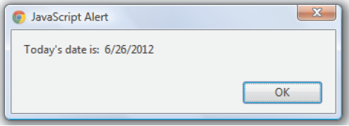
Date Object 3-3
The Code Snippet demonstrates the script that displays the current date in the
^{mm/dd/yyyy format.}
^{<script>}
^{function display_date()}
{
^{var today =new Date();}
^{var date =today.getDate();}
^{var month =today.getMonth();}
^{month++;}
^{var year =today.getFullYear();}
alert(‘Today\’s date is: ‘ + month + ‘/’ + date + ‘/’ + year);
}
^{display_date();}
^{</script>}

Slide 35
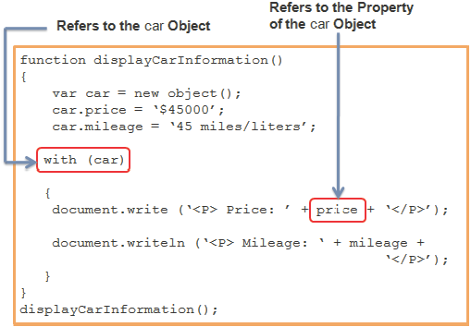
with Statement
with statement allows to remove the object reference for each JavaScript statement.
with statement starts with the with keyword followed by the open and close brackets, which holds the statements that refer to a common object.
with statement increases the readability of the code and also reduces time required in writing each object reference in every related statement.
Syntax to declare the with statement is as follows:
^{with(object_name)}
{
^{//Statements}
}

Slide 36
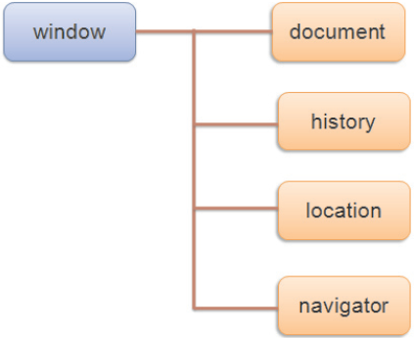
Browser Objects
JavaScript also provides objects to access and manipulate various aspects of the Web browser.
These objects are called as browser objects.
They exist on all pages displayed in the browser and correspond to elements of a page.

Slide 37
window Object 1-4
Provides properties that allows setting a default text for the status bar, name of the browser window, and so on
window Object
Is the top level object in the JavaScript hierarchy
window object represents a browser window and contains browser information
All the objects in the hierarchy are descendants of the window object

Slide 38
window Object 2-4
Following table lists the commonly used properties of the window object.
^{Property} | ^{Description}
^{defaultStatus} | Specifies or retrieves the default text to be displayed in the status bar of the browser window.
^{document} | Represents an HTML document that contains different elements.
^{history} | Contains history of the visited Uniform Resource Locators (URLs).
^{location} | Contains the content of the specified URL.

Slide 39
window Object 3-4
Following table lists the methods of the window object.
^{Method} | ^{Description}
^{alert()} | Displays an alert box that states the message and an OK button.
^{confirm()} | Prompts a dialog box that displays a message with the OK and Cancel buttons.
^{createPopup()} | ^{Creates a pop-up window.}
^{focus()} | ^{Focuses the current window.}
^{open()} | Opens the specified file in a new browser window.
^{prompt()} | Prompts a dialog box that accepts input from the user.

Slide 40
window Object 4-4
The Code Snippet demonstrates the methods of the window object.
^{<!DOCTYPE html>}
^{<head>}
^{<title> window Object </title>}
^{<script>}
^{function new_window() {}
if(confirm(‘Do you want to open a new page?’)) {
window.open(‘http://www.aptech-education.com/pages/about-us/about-aptech.html’, ‘_parent’);
}
^{else {}
window.alert(‘In the Current Window’);
}
}
^{</script>}
^{</head>}
^{<body>}
<input type=”button” value=”Click to move to the next page”onClick=”new_window();”/>
^{</body>}
^{</html>}

Slide 41
history Object 1-2
Allows you to determine the number of URLs in the history list by using the length property
history Object
Is a part of the window object
Is an array that allows referring to a particular URL by specifying its index number in the array
Contains a set of URLs visited by a user in a browser window

Slide 42
history Object 2-2
Following table lists the methods of the history object.
^{Method} | ^{Description}
^{back()} | Retrieves and displays the previous URL from the history list.
^{forward()} | Retrieves and displays the next URL from the history list.
^{go()} | Displays the specified URL. It accepts a parameter, which can either be a string or a number to go to specific page.

Slide 43
navigator Object 1-2
navigator Object
Contains information about the browser used by the client
Allows the user to retrieve information, such as name, version number, and so on
Following table lists the properties of the navigator object.
^{Property} | ^{Description}
^{appName} | Retrieves the name of the browser.
^{appVersion} | Retrieves the version number and platform of the browser.
^{browserLanguage} | Retrieves the language of the browser.
^{cookieEnabled} | Determines whether the cookies are enabled in the browser.
^{platform} | Retrieves the machine type such as Win32, of the client browser.

Slide 44
navigator Object 2-2
The Code Snippet demonstrates the use of navigator object to retrieve information of the browser.
^{<!DOCTYPE html>}
^{<head>}
<title> navigator Object </title>
^{<script>}
^{function display_browser() {}
document.write(‘Browser name: ‘ +navigator.appName+ ‘<BR/>’);
document.write(‘Browser version: ‘ +navigator.appVersion+ ‘<BR/>’);
document.write(‘Browser language: ‘ +navigator.browserLanguage+ ‘<BR/>’);
document.write(‘Platform: ‘ +navigator.platform+ ‘<BR/>’);
^{if(navigator.cookieEnabled) {}
document.write(‘Cookie is enabled in the browser.’);
}
}
^{</script>}
^{</head>}
^{<body>}
<input type=”button” value=”Browser Information” onclick=”display_browser()”/>
^{</body>}
^{</html>}

Slide 45
location Object
location Object
Allows to access complete information of the URL loaded in the browser window
Is a part of the Window object
Following table lists the properties and methods of the location object.
^{Property/Method} | ^{Description}
^{host} | Retrieves hostname and port number of the URL.
^{href} | Specifies or retrieves the entire URL.
^{pathname} | Specifies or retrieves the path name of the URL.
^{assign()} | Loads a new document with the specified URL.
^{reload()} | Reloads the current document by again sending the request to the server.
^{replace()} | Overwrites the URL history for the current document with the new document.

Slide 46
Document Object Model 1-3
A Web page contains various elements, such as buttons, text boxes, check boxes, and so on.
These elements exist in a hierarchy and overall represent an HTML document.
JavaScript allows the user to access HTML elements and also change the existing structure of an HTML page by using Document Object Model (DOM) specification.
DOM is an Application Programming Interface (API) that defines the object structure for accessing and manipulating HTML elements.
Is used with JavaScript to add, modify, or delete elements and contents on the Web page.
DOM specifications are laid by World Wide Web Consortium (W3C) and are implemented by all the browsers to overcome incompatibility issues.
DOM reads all the elements contained in an HTML page and treats the HTML elements as nodes.
The entire HTML document represents a document node. This document node consists of element nodes, attribute nodes, and text nodes. Document node is the highest level node and text nodes are the lowest ones.

Slide 47
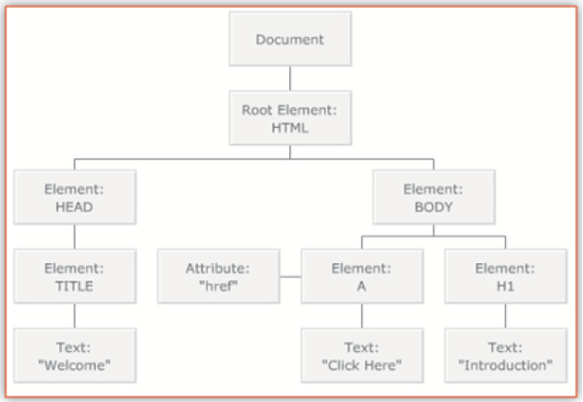
Document Object Model 2-3
The Code Snippet shows an HTML document.
^{<!DOCTYPE html>}
^{<html lang=”en”>}
^{<head>}
^{<title>Welcome</title>}
^{</head>}
^{<body>}
^{<h1> Introduction </h1>}
^{<ahref=”#”>Click Here</a>}
^{</body>}
^{</html>}

Slide 48
Document Object Model 3-3
All the nodes present in the node hierarchy contain certain properties.
These properties provide information about the node. The different node properties are as follows:
nodeName - Represents the name of the node. It contains the tag name of the HTML element in upper case.
nodeValue - Represents the text contained within the node. This property is only available for attribute nodes and not for document and element nodes.
nodeType - Represents the type of the node. For example, the document node, element node, and so on.
HTML DOM provides standard objects for HTML documents and some of these objects are as follows:
^{Document object}
^{Form object}
^{Link object}
^{Table object}

Slide 49
Document Object 1-3
Is used within the JavaScript to access all HTML elements presented on the page.
Represents the entire HTML document and provides access to other elements, such as links, anchors, and so on.
Has only one document object which is created when the BODY element is loaded on the Web page.
Is also the part of the window object and is accessed as, window.document.
Provides properties that allow the user to specify or retrieve the information about the elements and its content.

Slide 50
Document Object 2-3
Following table lists the commonly used properties of the document object.
Following table lists the commonly used methods of the document object.
^{Property} | ^{Description}
^{body} | Provides access to the BODY element.
^{title} | Specifies or retrieves the title of the document.
^{anchors} | Retrieves the collection containing all the anchors contained in a document.
^{forms} | Retrieves the collection containing all the forms contained in a document.
^{images} | Retrieves the collection containing all the images contained in a document.
^{links} | Retrieves the collection containing all the links contained in a document.
^{Method} | ^{Description}
^{close()} | Closes a data stream and displays the data collected using the open() method.
^{getElementById()} | Retrieves a collection of HTML elements by using the specified ID.
^{getElementsByName()} | Retrieves a collection of HTML elements by using the specified name.
^{getElementsByTagName()} | Retrieves a collection of HTML elements with the specified tag name.
^{open()} | Opens a stream to accept the output from write() or writeln() methods.
^{write()} | Writes the text or HTML expression to a document.

Slide 51
Document Object 3-3
The Code Snippet demonstrates how to use the document object.
^{<!DOCTYPE html>}
<head> <title> Document Object </title>
^{<script>}
^{function change_image() {}
var imgText=document.getElementById(‘myImg’).alt;
^{if(imgText==”ford”) {}
document.getElementById(‘myImg’).src=”ferrari.jpg”;
document.getElementById(‘myImg’).alt =”ferrari”;
document.getElementById(‘mytext’).value =”Ferrari Car”;
^{} else {}
document.getElementById(‘myImg’).src=”ford.jpg”;
document.getElementById(‘myImg’).alt =”ford”;
document.getElementById(‘mytext’).value =”Ford Car”;
} }
^{</script> </head>}
^{<body>}
<imgid=”myImg” src=”ford.jpg” width=”300” height=”300” alt=”ford” /> <br/>
Model: <input type=”text” id=”mytext” value=”Ford Car” readonly=”readonly”/><br/><br/>
<input type=”button” value=”Change Image” onclick=”change_image()”/>
^{</body>}

Slide 52
Form Object 1-2
Accepts input from the user and sends the user data for validation.
A single HTML document can contain multiple forms.
DOM specification provides a form object that represents an HTML form which is created for each <form> tag in an HTML document.

Slide 53
Form Object 2-2
The Code Snippet demonstrates how to use the form object.
^{<!DOCTYPE html>}
^{<head>}
^{<title> Form Object </title>}
^{<script>}
^{functiondisplay_length() {}
var count =document.getElementById(“form1”).length;
alert(‘Number of controls on the form: ‘ + count);
}
^{</script>}
^{</head>}
^{<body>}
<form id=”form1” action=”welcome.php”>
First name: <input type=”text” name=”firstname” value=”John” /><br />
Last name: <input type=”text” name=”lastname” value=”Smith” /><br />
Age : <input type=”text” name=”age” value=”40” /><br />
<input type=”button” value = ”Controls” onClick=”display_length()”/>
^{</form>}
^{</body>}
^{</html>}

Slide 54
Summary
A function is reusable piece of code, which performs calculations on parameters and other variables.
The return statement passes the resultant output to the calling function after the execution of the called function.
Objects are entities with properties and methods and resemble to real life objects.
There are two ways to create a custom object namely, by directly instantiating the Object object or by creating a constructor function.
JavaScript provides various built-in objects, such as String, Math, and Date.
JavaScript also provides browser objects, such as window, history, location, and navigator.
DOM is a standard technique for dynamically accessing and manipulating HTML elements. The DOM provides a document object which is used within the JavaScript to access all HTML elements presented on the page.

